Slide 1

Presentation Title
James Comer

Slide 2



Agenda
Theory
Design
Demo
Analysis
Evaluation

Slide 3
Features
Spheres, planes, cubes, and cylinders
PBR (or Blinn-Phong)
Shadows
Ambient occlusion
Reflectivity
Transparency and refraction
Real time with menus to adjust values
Multi-threaded
Uses thread pooling
Adjust number of tasks a frame is split into independent of the number of threads.

Slide 4
Theory – ambient occlusion
Optimised to split samples into smaller groups and test groups one by one. We exit early when no new samples hit something, assuming no ambient occlusion at this point. Avoids testing lots of samples unnecessarily.
Greatly increases performance in scenes where lots of points have no other object near so that point has no ambient occlusion.
Sample splitting creates false negative where we exit early assuming no ambient occlusion when if we tested more samples we’d find there is some.
Generate samples in a hemisphere and invert any that are past 90 degrees from the normal we’re looking at (dot product less than 0).
If a sample hits then we are more occluded and less ambient light should reach this point. (No samples hit all ambient light added, all samples hit no ambient light added, half samples hit half ambient light added)

Slide 5
Design
RayObject base class allows for easy creation of new shapes. Programmer only needs to write the code for the ray interception function and a normal at a given position function.

Slide 6
Demo

Slide 7
Analysis – test 1, threads
640 x 480 resolution, scene 1 with 64 samples ambient occlusion. Tested average frame time over 10 frames on Core i7-13700k 16 core CPU.
Tested 1 to 500 frames to see the difference in frame time.

Slide 8
Analysis – test 2, threads & tasks
640 x 480 resolution, scene 1 with 64 samples ambient occlusion. Tested average frame time over 10 frames on Core i7-13700k 16 core CPU.
Tested different number of tasks over set thread counts to see how the combination of tasks and threads impact frame time.

Slide 9
Analysis – test 3, ambient occlusion
640 x 480 resolution, scene 1 with 64 samples ambient occlusion. Tested average frame time over 10 frames on Core i7-13700k 16 core CPU, at 24 threads.
Tested different ambient occlusion sample sizes, as well as different number of splits on 2 scenes to see the difference in frame time between differently split samples, and then see how the percentage change differs on a different scene.

Slide 10
Evaluation
Different ambient occlusion sample sizes, see lower resolution of ambient occlusion.
Same sample size different split sizes, see false negatives. Show frame time, may decide it’s worth it.
My scene with scene in blender.

Slide 11
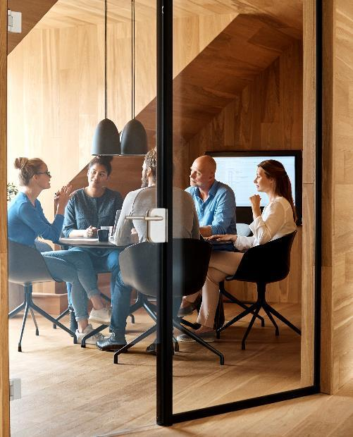



Introduction
With PowerPoint, you can create presentations and share your work with others, wherever they are. Type the text you want here to get started. You can also add images, art, and videos on this template. Save to OneDrive and access your presentations from your computer, tablet, or phone.

Slide 12

Topic one
Subtitle

Slide 13
Chart

Slide 14
Table
 | Category 1 | Category 2 | Category 3 | Category 4
Item 1 | 4.5 | 2.3 | 1.7 | 5
Item 2 | 3.2 | 5.1 | 4.4 | 3
Item 3 | 2.1 | 1.7 | 2.5 | 2.8
Item 4 | 4.5 | 2.2 | 1.7 | 7

Slide 15

The way to get started is to quit talking and begin doing.
Walt Disney

Slide 16




Team
Name
Name
Name
Name
Title
Title
Title
Title

Slide 17
Timeline
Title
To start a presentation, go to the Slide Show tab, and select From Beginning.
Title
To display Presenter view, in Slide Show view, on the control bar at the bottom left select the three dots, and then Show Presenter View.
Title
During your presentation, the speaker notes are visible on your monitor, but aren't visible to the audience.
Title
Title
If you can’t see the Notes pane or it is completely minimised, click Notes on the task bar across the bottom of the PowerPoint window.
The Notes pane is a box that appears below each slide. Tap it to add notes.

Slide 18
Content 2
Subtitle
subtitle
subtitle
Add text, images, art, and videos.
Add transitions, animations, and motion.
Save to OneDrive, to get to your presentations from your computer, tablet, or phone.
Open the Design Ideas pane for instant slide makeovers.
When we have design ideas, we’ll show them to you right there.
Add text, images, art, and videos.
Add transitions, animations, and motion.
Save to OneDrive, to get to your presentations from your computer, tablet, or phone.
Open the Design Ideas pane for instant slide makeovers.
When we have design ideas, we’ll show them to you right there.
Add text, images, art, and videos.
Add transitions, animations, and motion.
Save to OneDrive, to get to your presentations from your computer, tablet, or phone.
Open the Design Ideas pane for instant slide makeovers.
When we have design ideas, we’ll show them to you right there.

Slide 19

Summary
With PowerPoint, you can create presentations and share your work with others, wherever they are. Type the text you want here to get started. You can also add images, art, and videos on this template. Save to OneDrive and access your presentations from your computer, tablet, or phone.

Slide 20


Thank You
Presenter name
Email address
Website address

